Slide 1



Hamoye DashBoard
View in Power BI
Last data refresh:
9/6/2022 4:27:28 PM UTC
Downloaded at:
9/6/2022 9:43:33 PM UTC

Slide 2
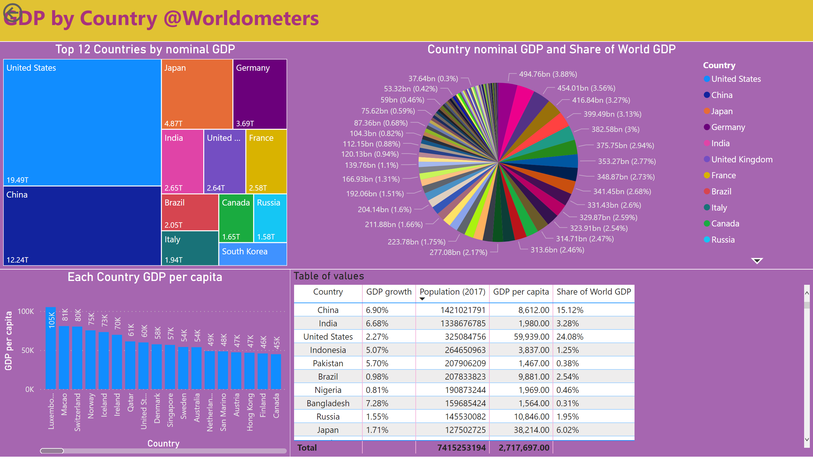
Page 1
Notes:
Top 12 Countries by nominal GDP
No alt text provided
textbox
No alt text provided
Each Country GDP per capita
No alt text provided
actionButton
No alt text provided
Country nominal GDP and Share of World GDP
No alt text provided
Table of values
No alt text provided

